Slide 1


MY PRIVATE LIFE BY CHRISTIAN JOSH B.GALLEGO
AUTOBIOGRAPHY

Slide 2
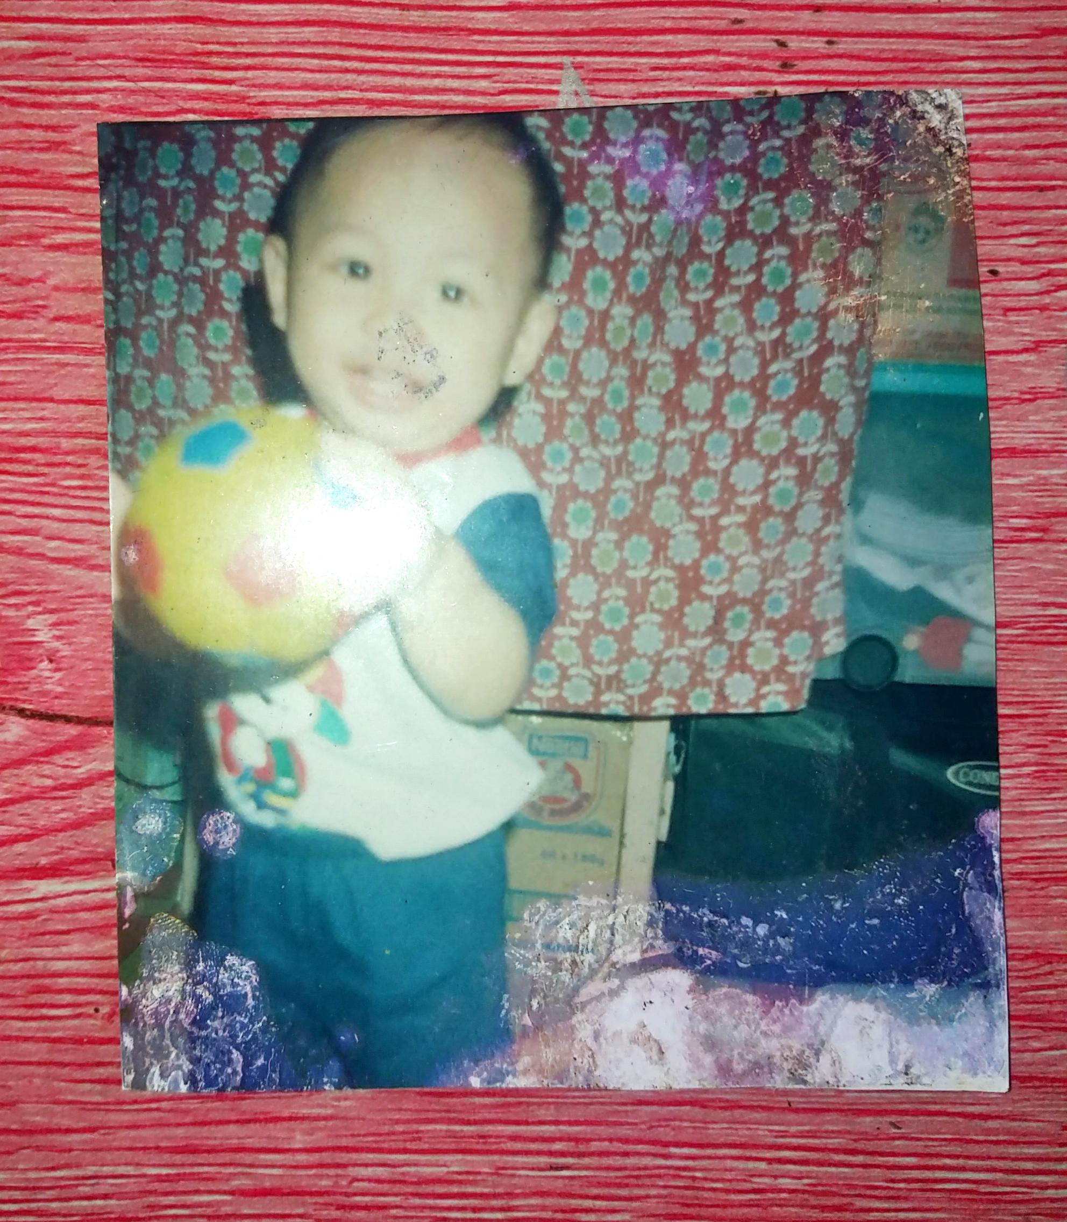
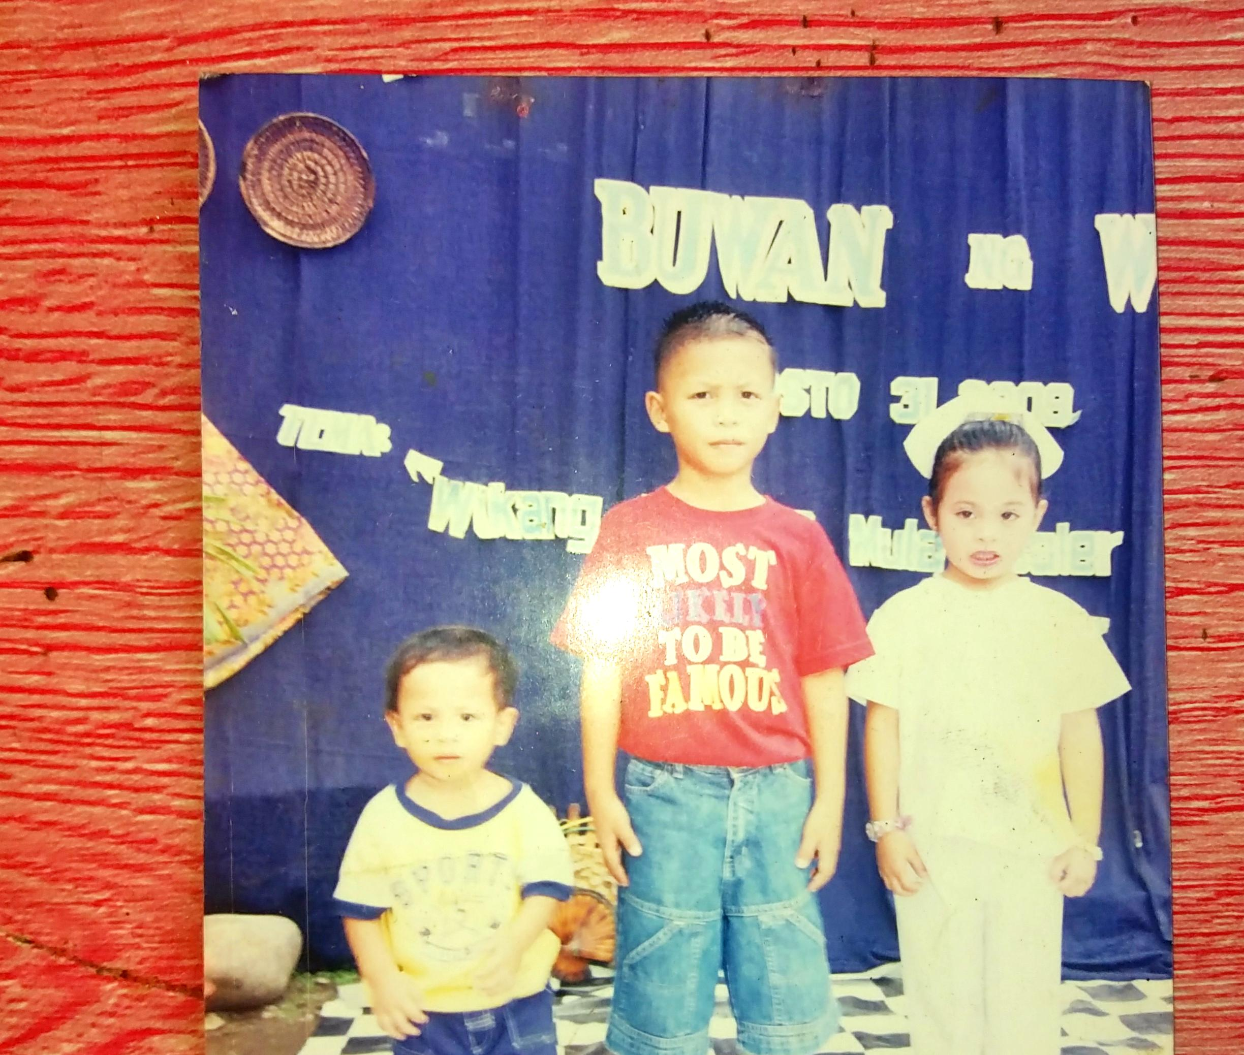
MY AUTOBIOGRAPHY
My mom and dad said that when I was a child I am so blessed that I could live in this world.cause I have an unstable immune system I always cry cause of my condition.
For god sake us I blesed that im alive mom and dad said that I am a joyful and happy person. I love to play a ball when I was a kid im happy to enjoy myself when at my childhood stage.when I go older and older I learn a lot of things now I learn to say basic language when I was a kid like saying mama and papa. Then after I healed from my condition I was a hyper kid that no one could expect. I felt emotional when I remember my happenings in my life when I was a kid. I hope this little biography in my life could impress my audience if he/she read.

Slide 3
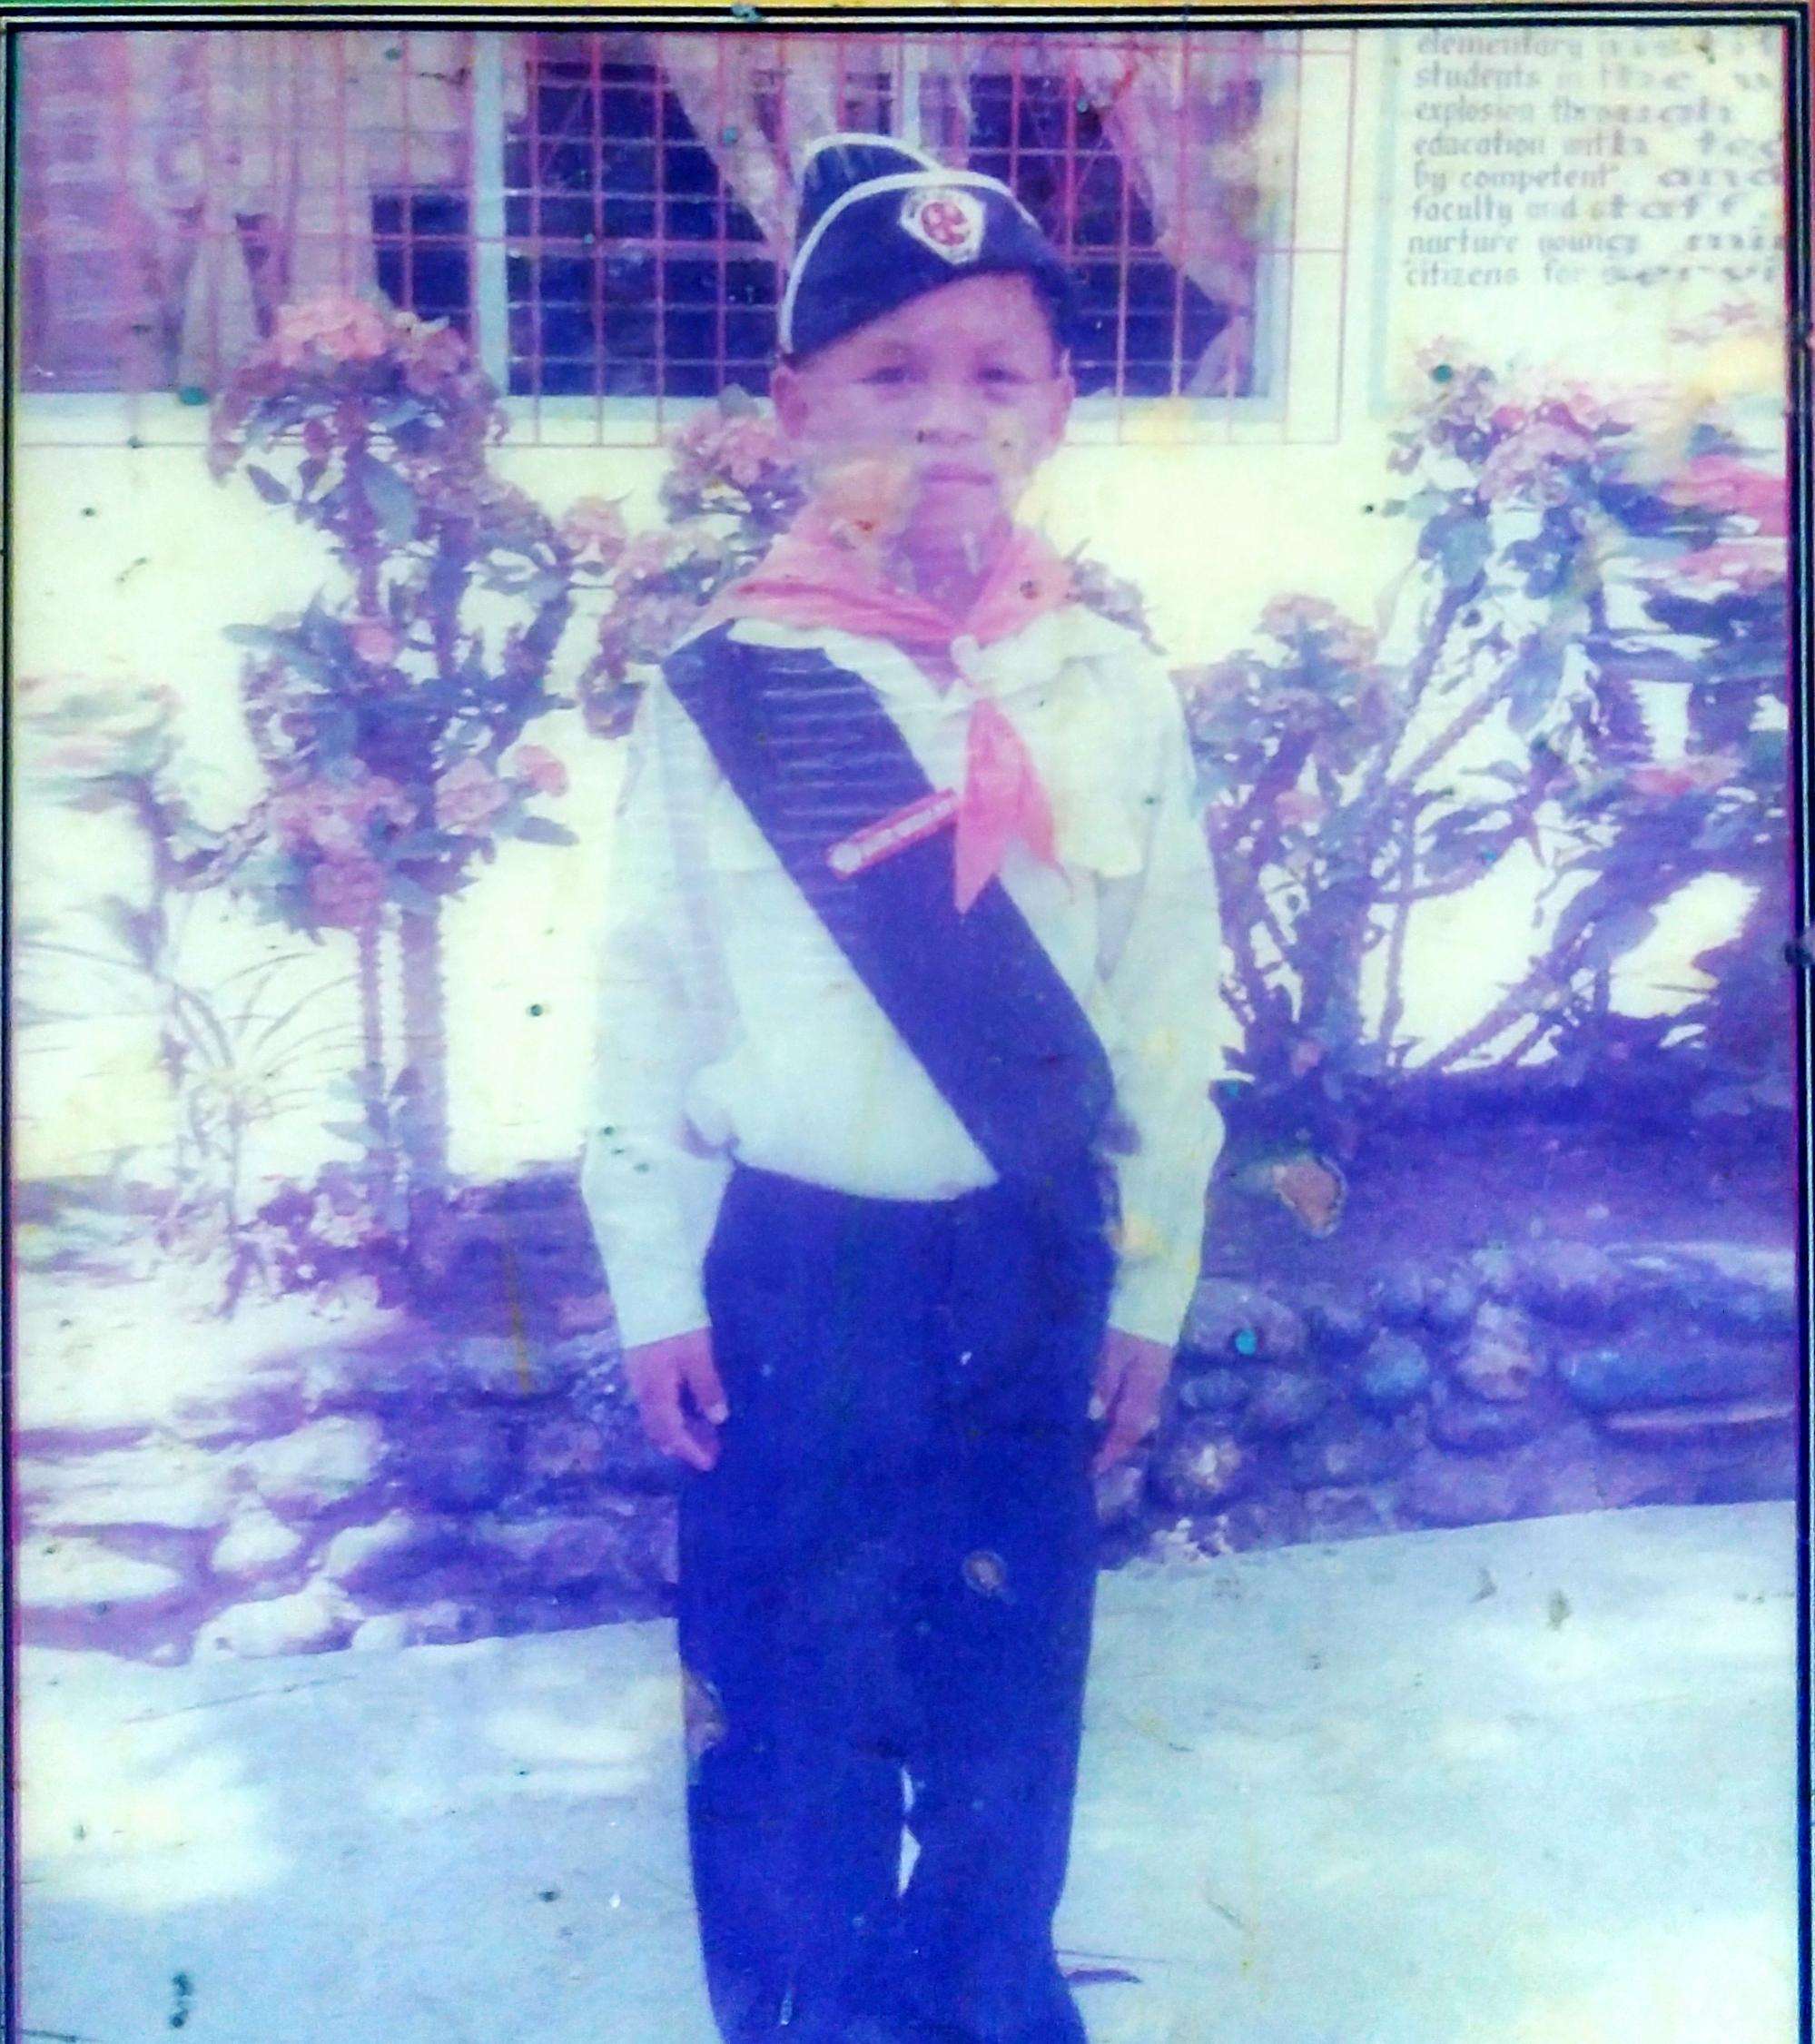
MY ELEMENTARY JOURNEY
My most memorable moments where in my Elementary days is I join in a boyscout club.when I stay joining in that activity I train myself to be an idependent so that I can stand by myself as a true boyscout. And then we do a lot of activities making a tend learn how to fetch water without using a pail I enjoy of what I am doing cause I know that it can help me someday of what ive learn in boyscout club.My ambition in life is to be an Police.to help and prevent criminal activity in our community with peace and order.I hope this little biography can help to My future someday.

Slide 4
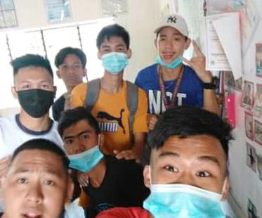
My High school journey
First of All I would like to introduce My name is Christian josh B.Gallego 19 years old now. I currently live in Purok 3 Brgy.Aguisan Himamaylan City Neg.occ My memorable and unforgettable moments of my highschool life is.when we go to a retreat in talisay City bacolod that’s our First and last trip cause its once in a lifetime. Me and my classmates are too excited to that trip and when we get there we eat dinner and do some indor activities. I felt happy on thqt day I could explain how is the feeling of true happiness when you are with you’re classmates and teachers.and then we wake up in the morning we eat breakfast washing ourself and listen to the testimony of our pastor about life. I felt emotional when I hear and feel the presence of God. And after all the activities have done we fix things to go home cause we’re all is feeling exhauted. So this is the simple journey on my high school life I hope you enjoy of my story in life.

Slide 5
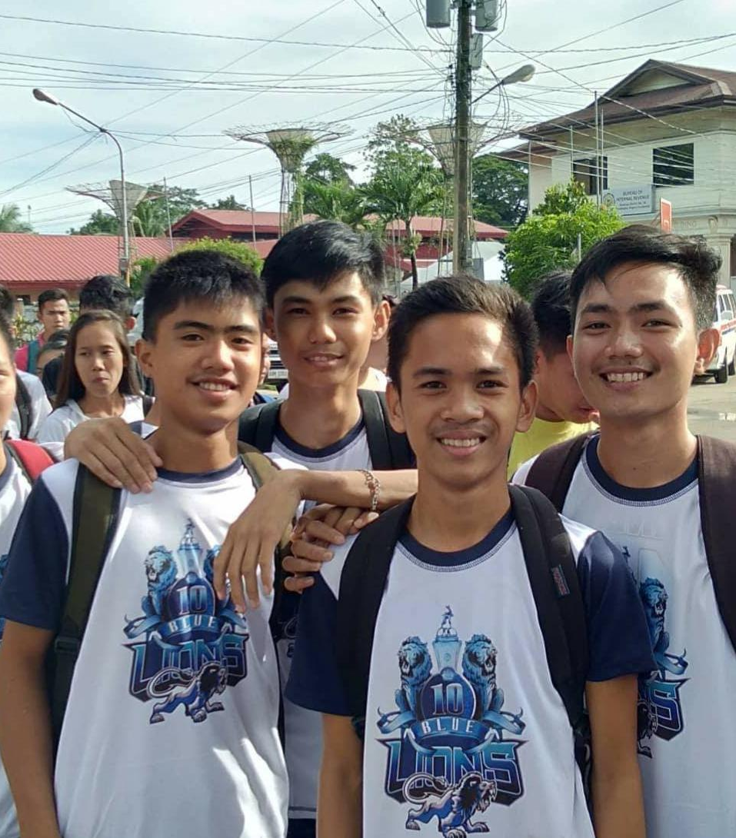
MY SENIOR HIGH JOURNEY
First I would like to introduce Myself I am Christian josh B.Gallego 19 years old my Father is Japet Gallego and my Mother is Frecy Gallego I have 3 Sisters and I brother im the eldest one. My senior high Journey and memorable moments is when I choose to be an independent person I know that senior high level is like a College life. So that I plan to wake up early comply my requirements to the designated subject. I have to focus in my goals to accomplish and commit my goals in life. I join many activities to make other impress. I am the prom king in our school since 2019-2020. I do my best cause I do a lot of expectations in my life. The main goal of every student is to Graduate so that I do my best to accomplish it is to graduate in This stage. I Hope this little Biography in my every journey could help To me career someday.

